Slide 1
Identity Theft & FTC Resources
October 19, 2022
Kelle Slaughter
Identity Theft Program Manager
kslaughter@ftc.gov | 214-979-9377

Slide 2
What We’ll Cover . . .
Understanding Identity Theft
Fraud and Identity Theft Trends
Reducing the Chances of Identity Theft
Steps to Recover from Identity Theft
FTC Resources

Slide 3
Identity Theft

Slide 4
What is identity theft?
Identity theft happens when a thief uses someone’s personal or financial information without their permission.

Slide 5
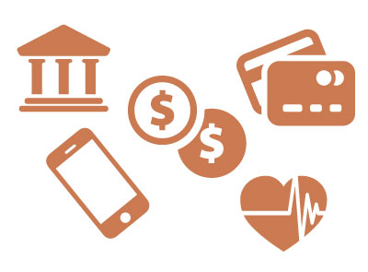
Examples of Misuse
The Impact
Open bank or credit card accounts
Open utility accounts
Apply for a tax refund
Get a loan
Apply for employment
Get medical care
Denial of credit/loans
Denial of public benefits
Denial of medical care
Denial/loss of employment
Harassment by debt collectors
Legal issues/arrest
Stress/anxiety
Recovery time/expense

Slide 6
Scope of the Problem
January – December 2021
1.4
million reports

Slide 7
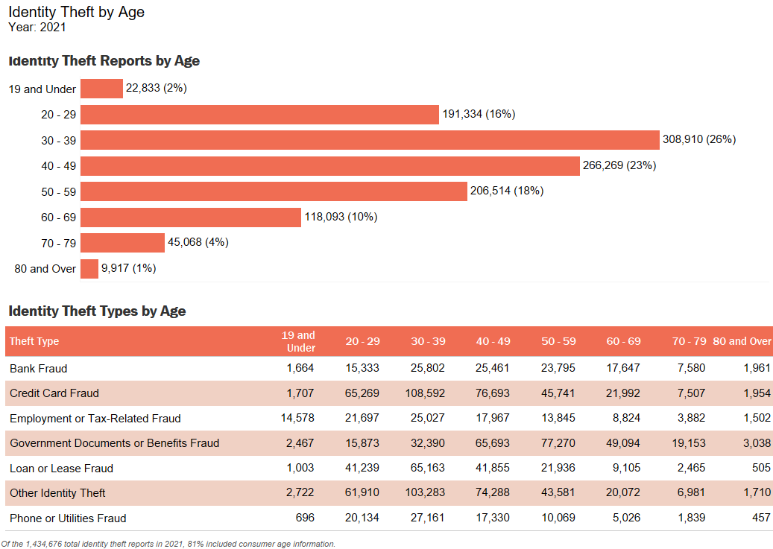

Slide 8
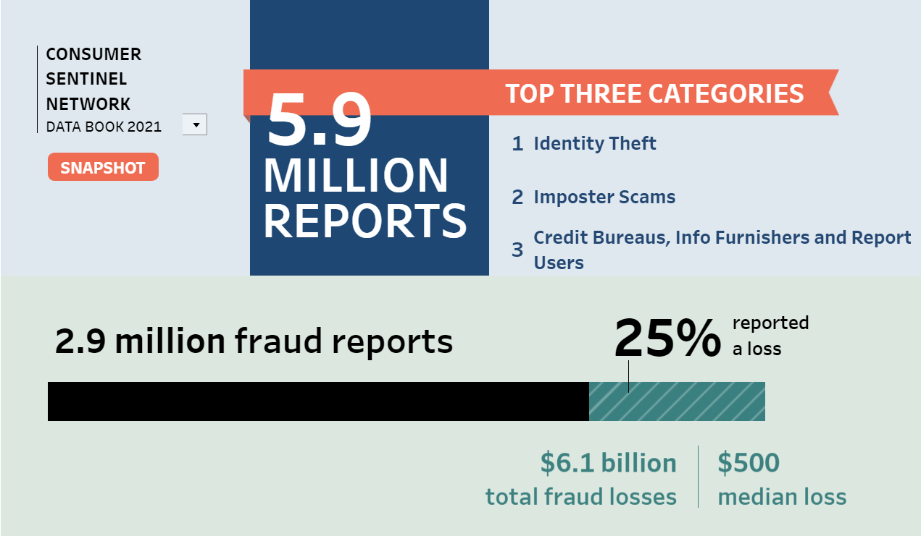

Slide 10
Fraud & Identity Theft Trends

Slide 11
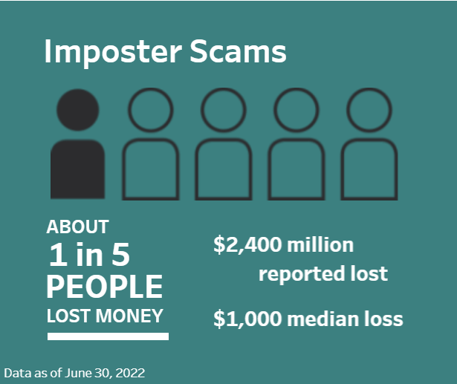
Government Imposter Scams
Scammers call, text, email, etc.
Request personal information or money
Demand gift cards, wire transfers or cryptocurrency
Use threats

Slide 12
Avoid Government Imposter Scams
HANG UP!
Do not trust caller ID
Check with the real government agency
Never pay by gift card, wire transfer, cash, or cryptocurrency
Report imposter scams to FTC at ReportFraud.ftc.gov

Slide 13
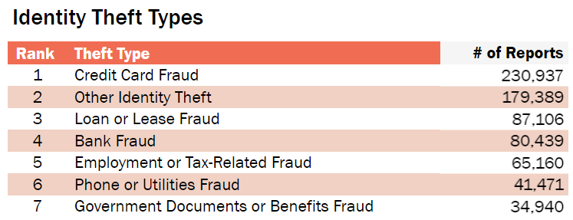
Credit Card Fraud
Credit card fraud is the unauthorized use of a credit or debit card, or similar payment tool (ACH, EFT, recurring charge, etc.), to fraudulently obtain money or property.

Slide 14
Avoid Credit and Debit Card Fraud
Use credit not debit, when possible.
Use ATMs inside bank (pay inside at gas stations), when possible.
Cover the keypad when entering PIN
Watch statements carefully. Report anything suspicious ASAP.
Don't email financial information
Report the incident to FTC

Slide 15
Avoid Identity Theft

Slide 16
Avoid Identity Theft: Offline
Clean out your wallet
Shred financial documents
Don’t share personal info when someone asks
Keep your info safe at home
Check the mail as soon as you can
Monitor your accounts and financial statements
Get your free credit report: AnnualCreditReport.com
Consider a credit freeze

Slide 17
Avoid Identity Theft: Online
Use strong passwords
Use multifactor authentication
Keep your security software up to date
Keep your operating system updated, too
Don’t click links in emails or texts that come out of the blue
Before you pay: is your connection secure?

Slide 18
AnnualCreditReport.com
Watch for
Incorrect name, address, SSN
Unknown accounts
Unknown balances on current accounts
High volume of inquiries from companies you have not contacted
Action steps
Review your report from each credit bureau often
Contact them to fix any mistakes (Learn more: ftc.gov/credit)
Suspect identity theft? Take action at IdentityTheft.gov

Slide 20
IdentityTheft.gov

Slide 21
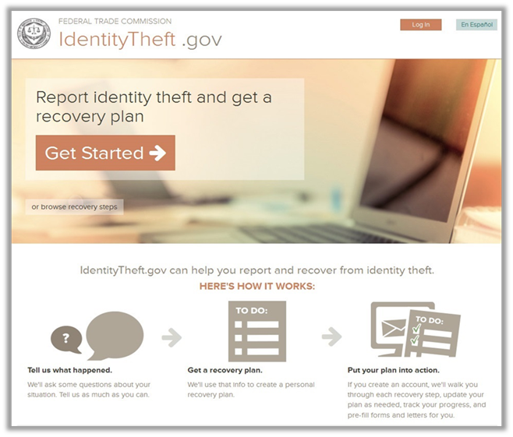

Slide 22
One-stop Resource
Streamlined process to report and recover
Personal recovery plans for more than 30 types of identity theft
Online consumer guidance
Create an Identity Theft Report
Customized sample letters
Reports shared with other law enforcement agencies

Slide 24
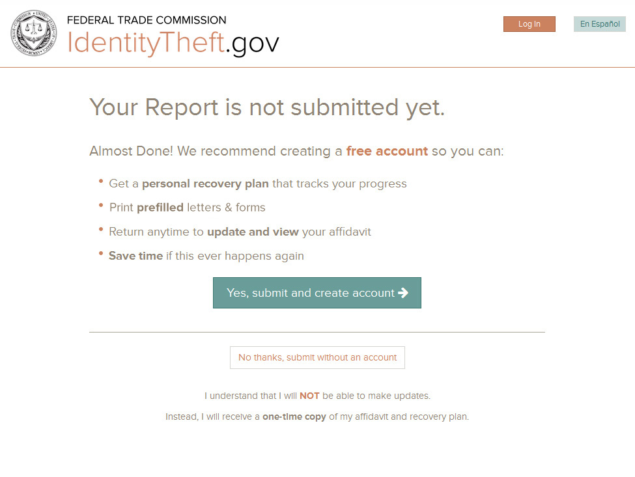

Slide 25
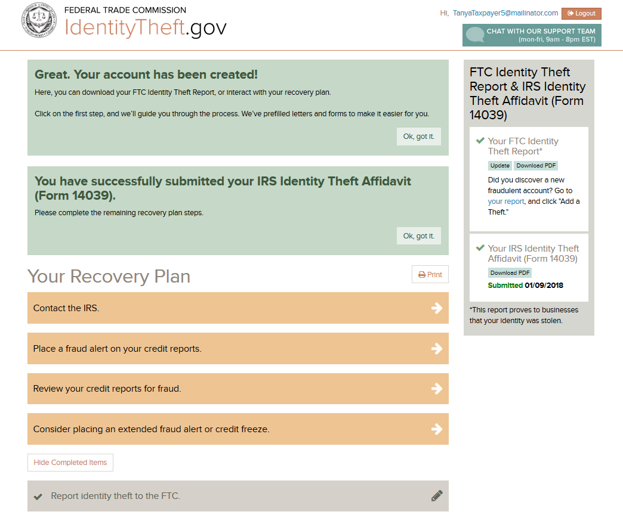

Slide 26
FTC Resources

Slide 27
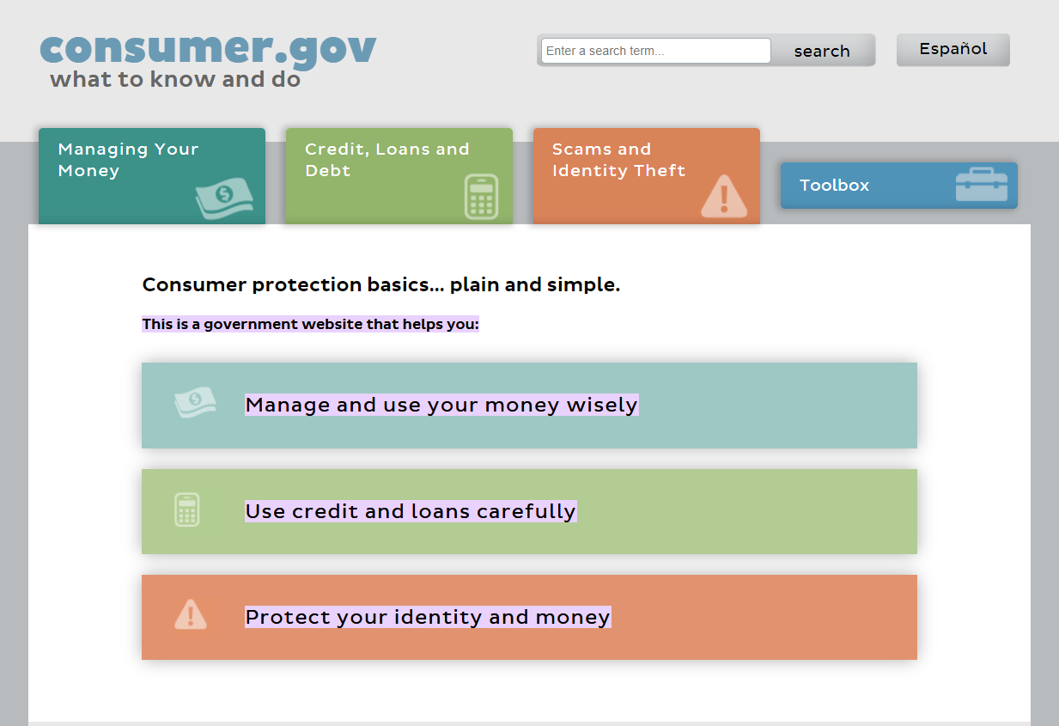

Slide 28
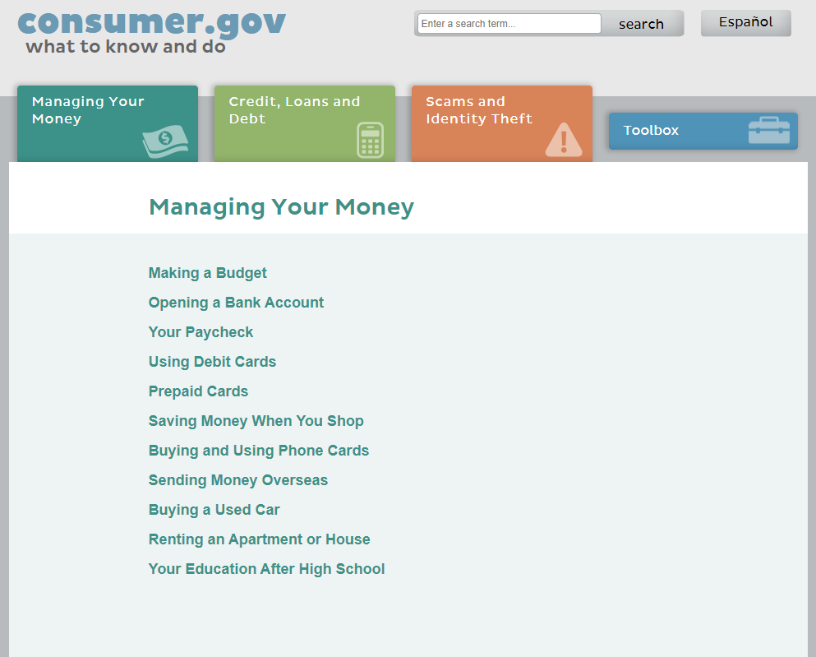

Slide 29
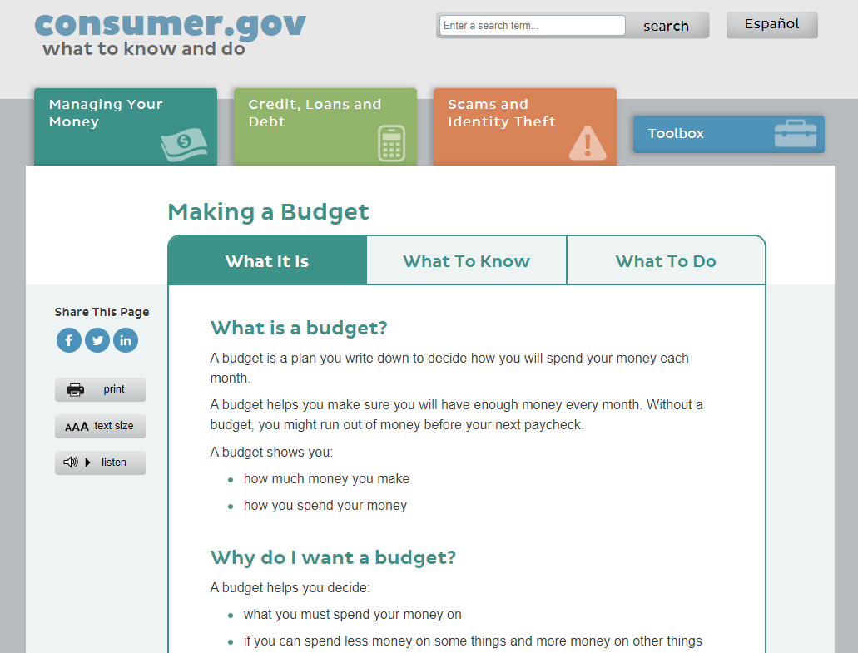

Slide 30
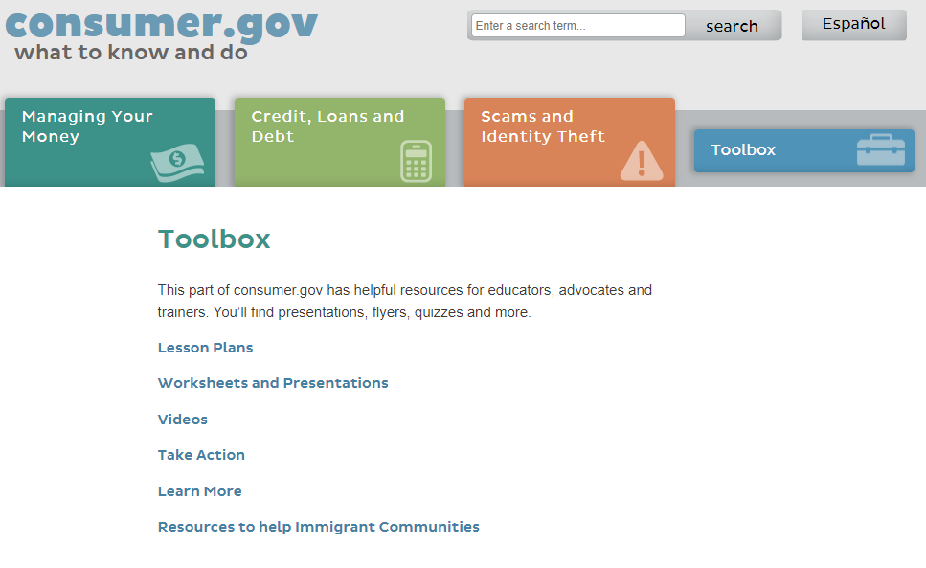

Slide 31
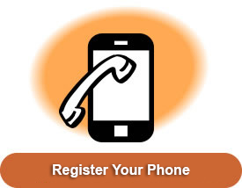
Unwanted Calls & Texts
Register all of your telephone numbers at DoNotCall.gov or 1-888-382-1222
Forward suspicious text messages to SPAM (7-7-2-6)
Use the call blocking technology on your phone for calls and text messages

Slide 32
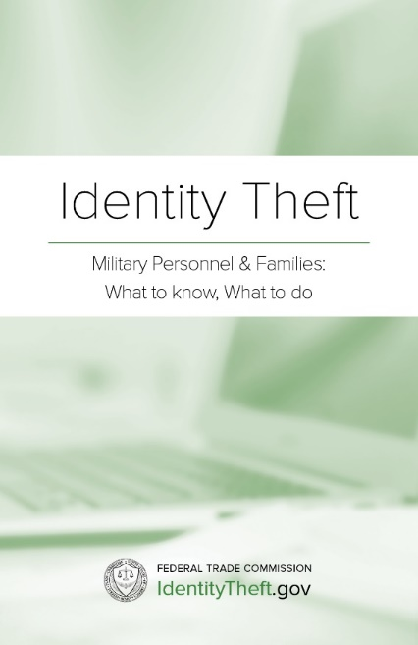
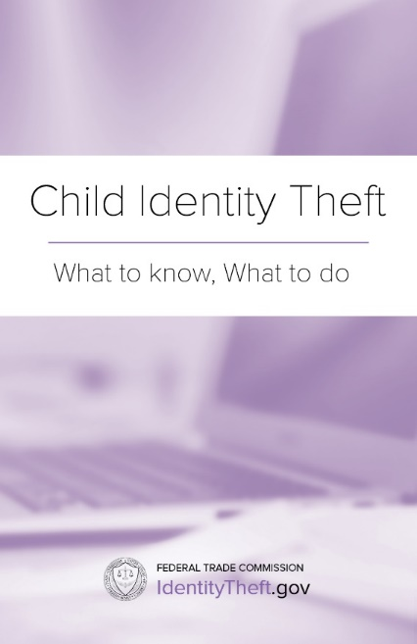
Learn more: ftc.gov/idtheft
Order FREE publications: ftc.gov/bulkorder

Slide 33
Spot Scams – and Stay In Touch
Learn how to avoid identity theft and other scams:
consumer.ftc.gov
Sign up for Consumer Alerts:
ftc.gov/consumeralerts

Slide 34
SPANISH: ReporteFraude.ftc.gov

