Slide 1
We will begin shortly...
Once the main presentation begins, you should
hear audio through your computer. If you do not, please check your computer settings.
To help with audio please close all other windows. If your settings are correct and you continue to have audio problems, please log out and log back in.
Thank You!
1
Notes:
Five minutes before:
Hello Everyone, we will begin at the top of the hours. The presentation we are doing today is available in the materials tab and can be downloaded for future reference.
There is also a chat box available where you can add any questions you may have during the presentation, and we will have a Questions & Answer session at the end of the presentation.

Slide 2

Stakeholder Partnerships, Education & Communication
Native American Indian Initiative Gathering
Notes:
Welcome to the First Annual Native American Indian Initiative Gathering.
SPEC has developed partnerships with several partner that serve the Native American Indian population. They provide EITC outreach, free tax preparation services and financial education for community members. They are dedicated people who have turned to strengthening tribal economies using the tools of tax information and free tax preparation.

Slide 3
Stakeholder Partnerships, Education & Communication
Our Mission is to increase access to tax information, free tax services and financial education throughout the Native American Indian population; strengthening tribal communities and economies.

Slide 4
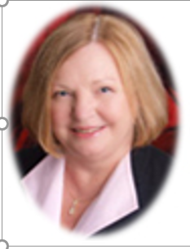
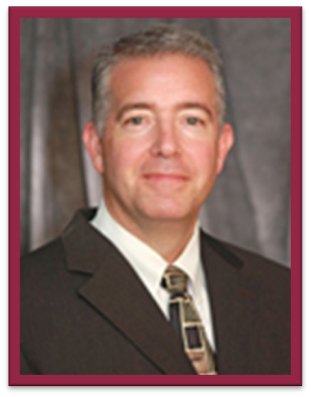
David Alito,
Area 1 Director
Stakeholder Partnerships, Education & Communication
Stakeholder Partnerships, Education & Communication
Sue Simon, Director
Customer Assistance, Relationship & Education
Notes:
Introduction of Directors

Slide 5
Stakeholder Partnerships, Education & Communication
Meet the SPEC Team Members:
Dena Baker Barb Opitz
Beverly Lemon Sikeyaa Robinson
Linda Fritz-Langston Jana Sims
Williette McKinney Ferrell Greg Wilkinson
Matthew O’Connor Jessica Wilson
Notes:
MEET OUR TEAM -

Slide 6
Stakeholder Partnerships, Education & Communication
Meet our Partners
Notes:
Relationship Managers to introduce Partners

Slide 7
Stakeholder Partnerships,
Education & Communication
SAIGE
Society of American Indian Government Employees
Honoring our Ancestors through Government Service
Jennifer Cantrel
Notes:
DENA BAKER - Formed in 2002, SAIGE is the first national non-profit organization representing American Indian and Alaska Native Federal, Tribal, State, and local government employees.
SAIGE hosts an outstanding Annual National Training Program, open to all, focused on professional development, leadership and topics related to the complex Federal Indian Trust Responsibility. Integral to this, SAIGE provides specialized training sessions for Veterans and Youth.

Slide 8

Stakeholder Partnerships,
Education & Communication
Oklahoma Native Assets Coalition
Christy Finsel
Executive Director
www.oknativeassets.org
cfinsel@oknativeassets.org
Notes:
BEVERLY LEMON - The purpose of the ONAC Native EITC/VITA Network is to share resources and opportunities, to provide a platform for interaction among Native site coordinators (American Indians, Alaska Natives, and Native Hawaiians), and to bring concerns from Native VITA sites to appropriate parties.

Slide 9
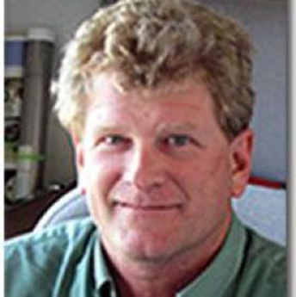
Stakeholder Partnerships,
Education & Communication
Agricultural & Resource Economics
Associate Director for Tribal Extension Programs
Agricultural Economics
Extension Specialist
Trent Teegerstrom
Production Economics, Crop Budget
Development & Risk Management Education
Notes:
LINDA LANGSTON - As the Associate Director for Tribal Extension Programs, Mr. Teegerstrom’ s responsibilities include aiding in the management and direction of tribal extension programs. As an Extension Specialist in the Department of Agricultural and Resource Economics, his responsibilities include working in the areas of production economics and risk management education including cost and return estimates for the state's agriculture industry, beginning farmer and rancher initiatives, agricultural labor, and risk management.

Slide 10
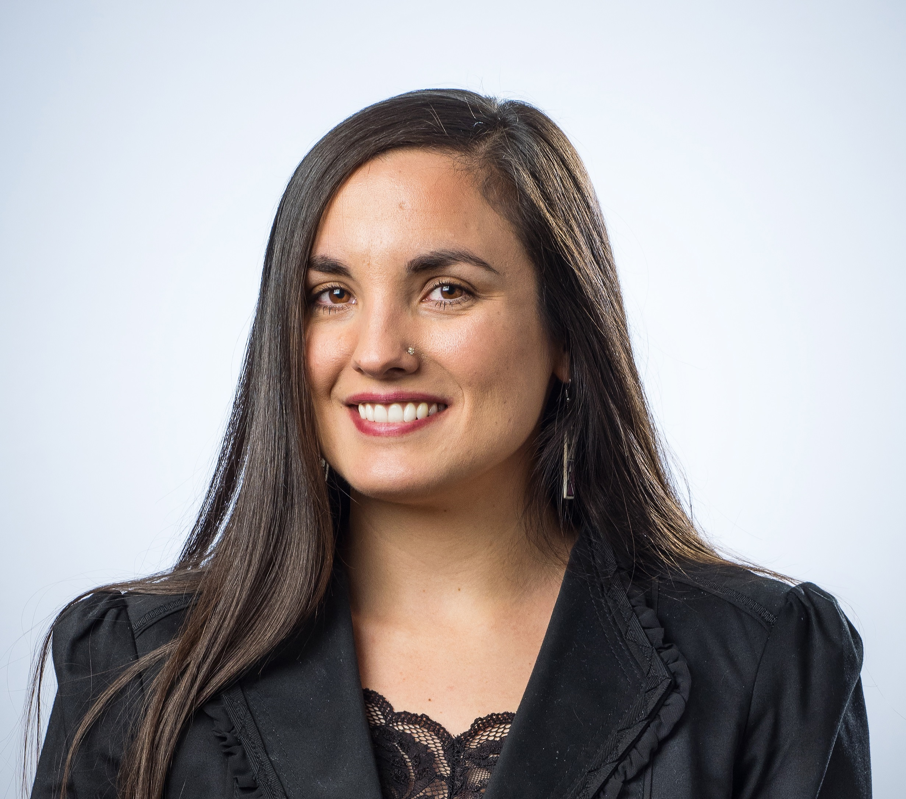

Stakeholder Partnerships,
Education & Communication
Notes:
WILLIETTE McKINNEY-FERRELL - Oweesta Corporation was created 21 years ago to address the lack of capital and financial infrastructure holding back economic development in Native communities. They believe that when armed with the appropriate resources, Native peoples hold the capacity and ingenuity to ensure the sustainable, economic, spiritual, and cultural well-being of their communities. Oweesta has been instrumental in establishing statewide Native American coalitions, providing technical
assistance that supports VITA efforts and promoting tax benefits and services throughout Indian nations.

Slide 11
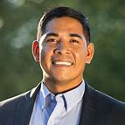

Stakeholder Partnerships,
Education & Communication
Rudy Soto
U S. DEPARTMENT OF AGRICULTURE
State Director for Idaho
Notes:
Greg Wilkinson- Rudy Soto is a member of the Shoshone Bannock Tribes of the Fort Hall Reservation. He is a proud veteran of the United States Army National Guard. He is passionate about serving rural communities like the ones he comes from in Idaho and ensuring people from all walks of life have access to affordable housing, broadband, and pathways out of poverty.

Slide 12
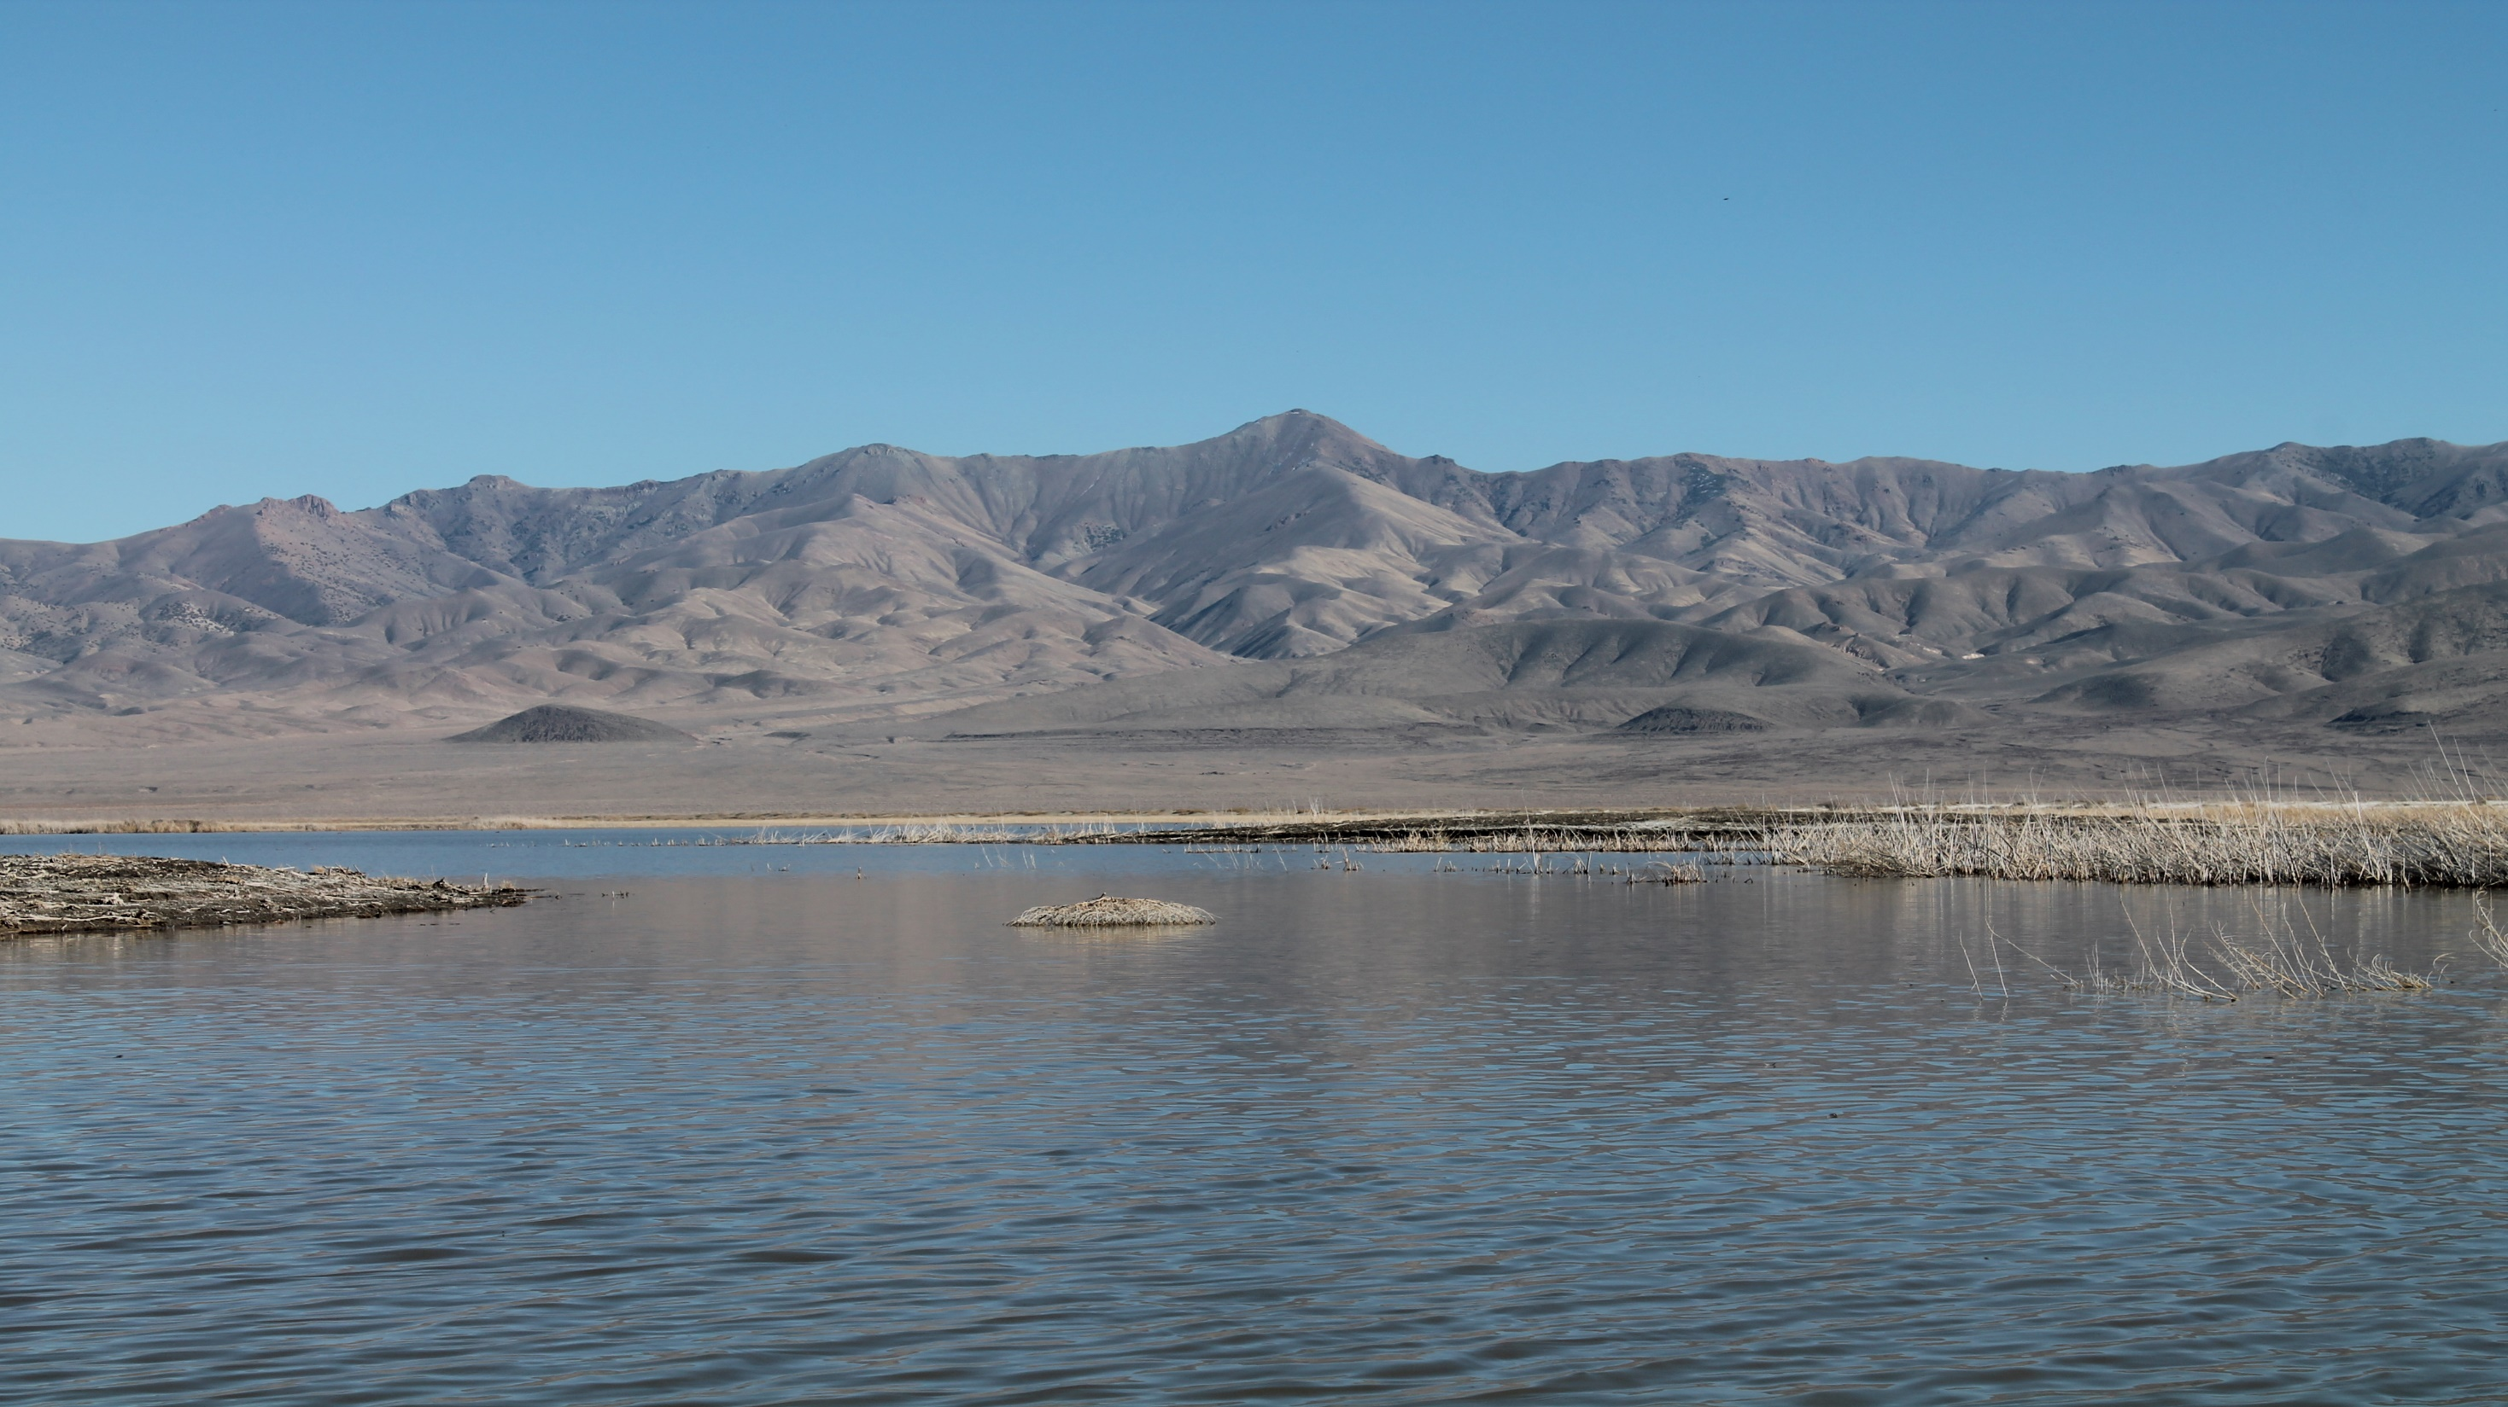

Fallon Paiute-Shoshone Tribe
Volunteer Income Tax Assistance (VITA) Program
Notes:
Linda Langston – Melanie McFalls

Slide 13
Why VITA
The VITA program has been providing services to our tribal community
members since 2013. The need for this service
was important and vital to people who needed all of their refund
and not what was left out of their refund after tax preparation
fees have been applied when using a paid tax preparer, sometimes that led
to a balance due to the IRS, plus the tax preparation fees to those
who owed.
Those we serve have very limited income, whether its earned or social
security income or both. It has been a great benefit to our people and the
surrounding community.

Slide 14
Training
Site Coordinator Training and Tax Preparation training is done online
You’ll receive books to guide you through your software and tax preparation, provided to you for free by the IRS.
The Tax Software is free.
The Tax Software has a customer service line where they can assist with software issues or questions.
Once you have completed your training certifications, you are ready to get your site going.

Slide 15
Benefits
Direct Deposit is preferred to get their refunds faster.
Most people get their refund within 7-10 days.
They are not paying other tax preparers to prepare their tax returns; this means more money in their pockets by not having those extra fees deducted from their refund.
This service is free for those that are eligible.
Can file extensions electronically for free, sometimes this is a cost at most paid preparers
Some Tribal members feel more comfortable coming to a native site, you gain that personal relationship with them and they feel more comfortable coming to you for tax questions or letters that they get from the IRS.
“It feels good to hear people get excited knowing they have a refund coming and most of all when they say really? I actually get a refund”

Slide 16
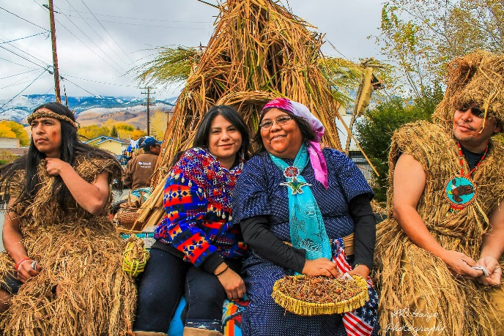
Challenges
Seeking Volunteers
Gaining Trust from your tribal members and the people within your community. Small Community, tribal communities have a hard time telling someone their personal business, so gaining trust and them knowing you hold their information in strict confidence is important.
Getting the word out can also be challenging, sometimes people won’t understand VITA until they have actually used the service.

Slide 17
Helpful Tips
Educate your community on the Volunteer Income Tax Assistance (VITA) Program – Handouts, community newspapers or newsletters, social media, utilize your programs to help with providing information, post fliers in the community and your local businesses.
Don’t forget your elders – Going to your Senior Center and speaking with the elders about the program is very important.
Once you start taking in taxpayers, they start gaining your trust in preparing their tax returns, they will start referring their friends, families, co-workers and whoever else can benefit from this program.
Always advocate for your VITA program, keep spreading the word.

Slide 18

Melanie McFalls
Fallon Paiute-Shoshone Tribe
Tax and TERO Administrator
Phone: 775-423-6075, ext. 1017
taxdirector@fpst.org

Slide 19
Stakeholder Partnerships,
Education & Communication
Indian Tribal Government (ITG)
Tax Information for Indian Tribal Governments
Tax Law & Guidance
Tribal Governments
Employment Tax
Carole Oller Tribal Members Indian Tribal Governments Gaming
Technical Group
Gaming
Notes:
MATTHEW O’CONNOR - The Indian Tribal Government office provides its customers top quality service by helping them understand and comply with applicable tax laws and protecting the public interest by applying the tax law with integrity and fairness to all. ITG is guided by principles of respect for Indian tribal self-government and sovereignty.

Slide 20
Stakeholder Partnerships,
Education & Communication
Stakeholder Liaison Field
Payroll and Practitioner Communities
Small Business and Industry
Government Organizations
Marc Zine
Project Manager, Stakeholder Liaison
IRS Communications & Liaison
Notes:
,
BARB OPITZ - I can recap our AIAN filing season outreach that focused on tribal leadership and the CTC/RRC benefits for people who don’t normally file returns. Stakeholder Liaison Field (SLF) focuses on local engagement of the payroll and practitioner communities, Small Business and Industry, and Government organizations to provide information about IRS policies, practices and procedures.

Slide 21

Deputy Executive Director
Traci Wilnerd
Low Income Taxpayer Clinic
Tamara Borland
https://www.taxpayeradvocate.irs.gov/
Notes:
JANA SIMS -As an independent organization within the IRS, TAS assists taxpayers in resolving tax problems with the IRS, identifies areas in which taxpayers have problems with the IRS, and makes administrative and legislative recommendations to resolve systemic tax issues.

Slide 22
Stakeholder Partnerships,
Education & Communication
National Partnerships
To build and maintain partnerships both internally and externally to support SPEC's mission
Cecilia James
Tax Analyst
SPEC Headquarters
Notes:
Jessica Wilson - Mission: To identify national organizations that have a shared mission of serving low-income, elderly, rural and limited English proficiency clients, and maintain relationships with those organizations to leverage and engage their resources to inform, educate, and communicate with our customers by implementing strategies through a community-based partnership model.

Slide 23
CLOSING REMARKS

